Slide 1
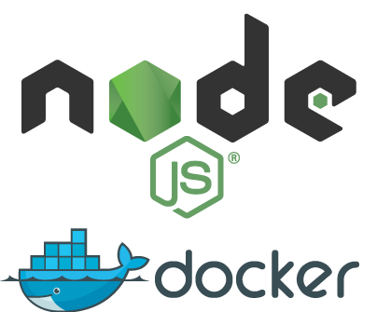
Lab 2: Deploying Containers with AWS
Using EC2 ECS to create container services, and interfacing with ECR as a container registry
Time to finish: ~25 min

Slide 2
Task
2-aws-containers
Deploy two containers (API and DB) which connect using ECR and EC2 ECS.
You will need:
Access to AWS
Local copies of the node application
Located inside of code/banking-api

Slide 3
Walk-through
2-aws-containers
If you would like to attempt the task, then skip the walk-through and go for the task directly. However, if you need a little bit more hand holding or you would like to look up some of the commands or code or settings, then follow the walk-through.
Steps to deploy a two-container project (app + database):
Create registry (ECR)
Upload the app image to ECR
Create task definition with 2 containers
Create a cluster
Create a service and run it

Slide 4
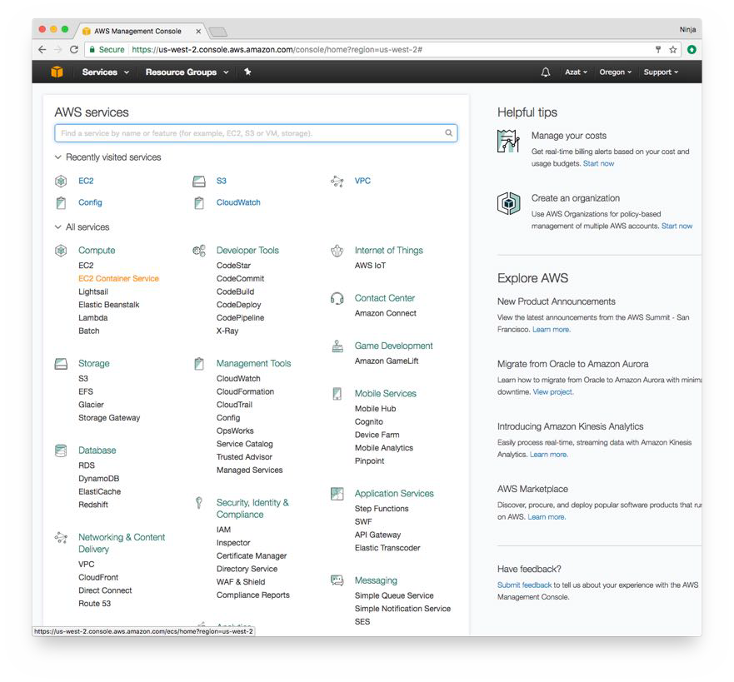
1. Create registry (ECR)
2-aws-containers
Each image needs to be uploaded to a registry before we can use it to run a container. There is registry from docker: hub.docker.com. AWS provides its own registry service called EC2 Elastic Container Registry (ECR). Let’s use it.
Log in to your AWS web console at aws.amazon.com. Navigate to us-west-2 (or some other region, but we are using us-west-2 in this lab) and click on EC2 Container Service under Compute:

Slide 5
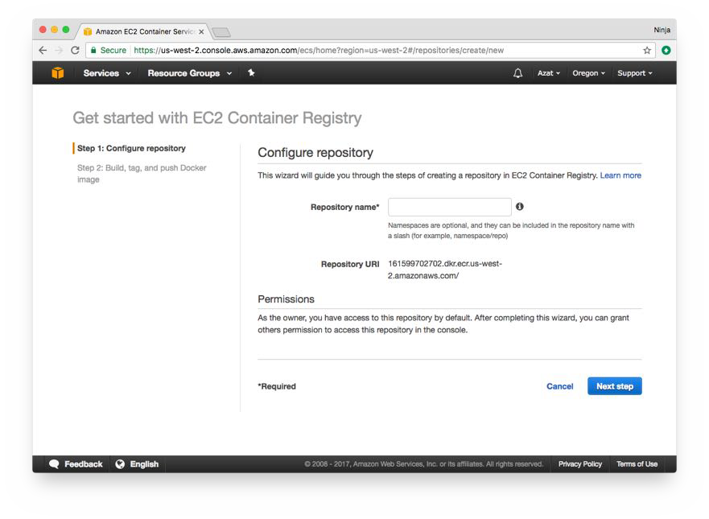
2-aws-containers
Then click on Repositories from a lift menu and on a blue button Create repository. Then new repository wizard will look like this:
Enter the name of your repository for container images. You might call it <your-name>-container-repo, for example.

Slide 6
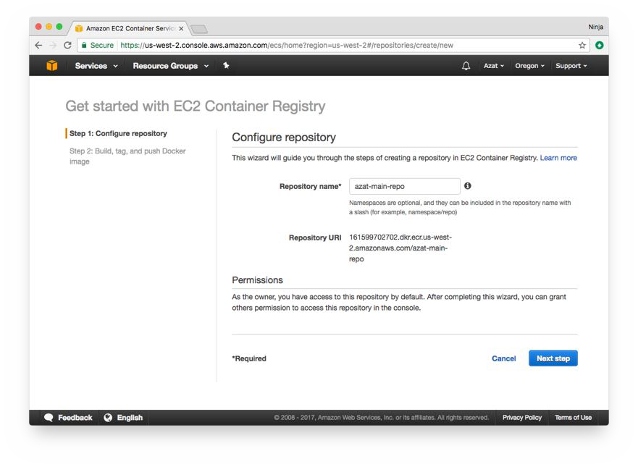
2-aws-containers
Click next and on Step 2, you will see bunch of commands.

Slide 7
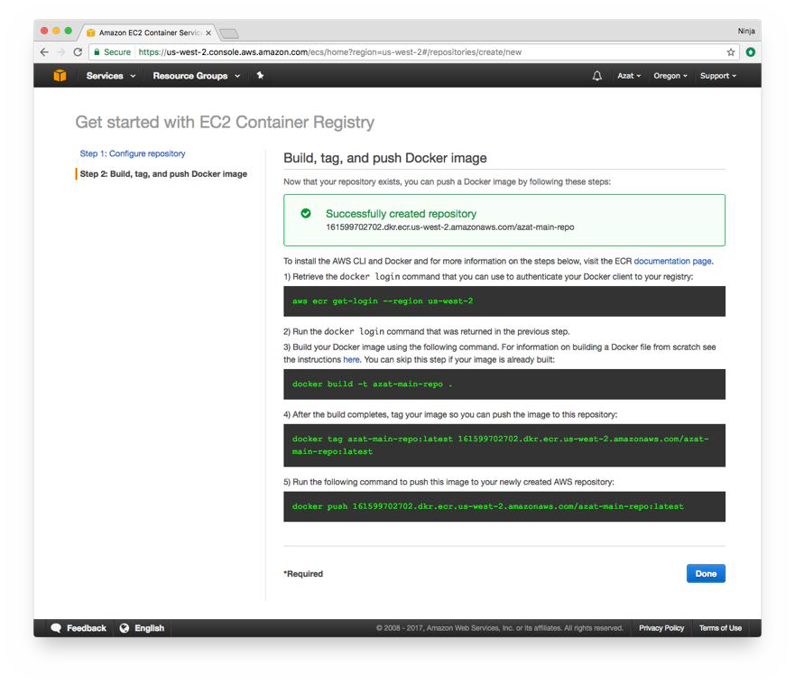
2-aws-containers
Successfully created repository, e.g., URL is
161599702702.dkr.ecr.us-west-2.amazonaws.com/your-name-container-repo
Next, follow instructions to upload an image (must build it before uploading/pushing).
To install the AWS CLI and Docker, and for more information on the steps below, visit the ECR documentation page.
Command 1: Retrieve the docker login command that you can use to authenticate your Docker client to your registry:

Slide 8
2-aws-containers
aws ecr get-login --region us-west-2
Command 2: Run the docker login command that was returned in the previous step. For example,
docker login -u AWS -p eyJwYXlsb2FkIjoiQ1pUVnBTSHp FNE5OSU1IdDhxeEZ3MlNrVTJGMUdBRlAxL1k4MDhRbE5lZ3JUW
... W5VK01Ja0xQVnFSN3JpaHCJ0eXBlIjoiREFUQV9LRVkifQ==
-e none https://161599702702.dkr.ecr.us-west-2.amazonaws.com
Results:
Login Succeeded
Command 3:: Build your Docker image using the following command. For information on building a Docker file from scratch see the instructions here. You can skip this step if your image is already built:
cd code/banking-api
docker build -t my-container-repo .
You might have done this already in the lab 1 (labs/1-dockerized-node.md). Skip to step 4. If not, then build the app image. The build command should end with a similar looking output:
...
Step 13/13 : CMD npm start
> Running in ee5f0fb12a2f
> 91e9122e9bed
Removing intermediate container ee5f0fb12a2f Successfully built 91e9122e9bed
Command 4: After the build completes, tag your image so you can push the image to this repository:
docker tag my-container-repo:latest 161599702702.dkr.ecr.us-west-2.amazonaws.com/my-container-repo:latest
(No output)
Command 5: Run the following command to push this image to your newly created AWS repository:

Slide 9
2-aws-containers
docker push 161599702702.dkr.ecr.us-west-2.amazonaws.com/my-container-repo:latest
Push output example:
The push refers to a repository [161599702702.dkr.ecr.us-west-2.amazonaws.com/my-container-repo]
9e5134c1ad7a: Pushed e949bf24b1c4: Pushed 2b5c968a7072: Pushed 858e5e857851: Pushed 10e038bbd0ad: Pushed ad2f0f4f7c5a: Pushed ec6eb0ab894f: Pushed e0380bb6c0bb: Pushed 9f8566ee5135: Pushed
latest: digest: sha256:6d1cd529ced84a6cff1eb5f6cffaed375717022b998e70b0d33c86db26a04c7 4 size: 2201
Remember digest (last hash) " Compare digest with one in the repository when you look up your image in the web console in EC2 -> ECS -> Repositories -> my-container-repo:

Slide 10
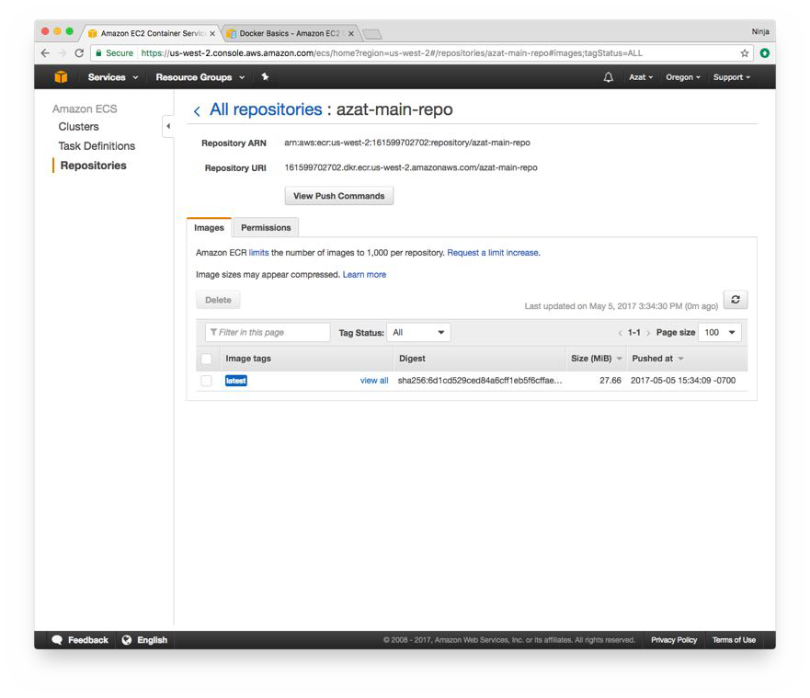
2-aws-containers
10 of 28

Slide 11
2. Create new Task Definition
2-aws-containers
Tasks are like run commands in docker CLI (docker run) but for multiple containers. Typical tasks define:
Container images to use Volumes if any Networks
Environment variables Port mappings
Go to the Task Definitions in EC2 ECS and as you might guess, press on the button which says Create new Task Definition:

Slide 12
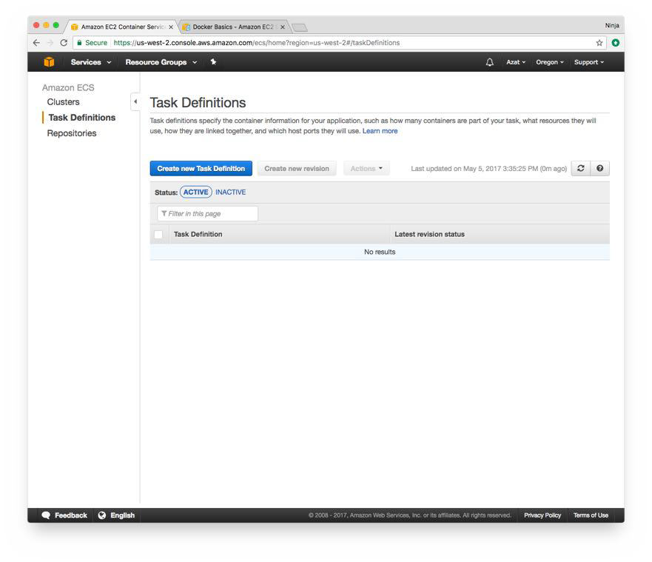
2-aws-containers
Main Task settings for the example
Use the following settings for the task to make sure your project is running (because some other values might make the project nonfunctional):
Two containers: banking-api (private AWS ECR) and mongodb (docker hub) Connect to mongodb via network alias
Map 80 (host) to 3000 (container) for banking-api Set env vars for NODE_ENV and DB_URI

Slide 13
First container—App
2-aws-containers
Enter the name: banking-api-container.
Define the image URL (your URL will be diﬀerent), e.g.,
161599702702.dkr.ecr.us-west-2.amazonaws.com/my-container-repo:latest
Define host 80 and container 3000 ports in port mappings. Name, image and ports are shown below:

Slide 14
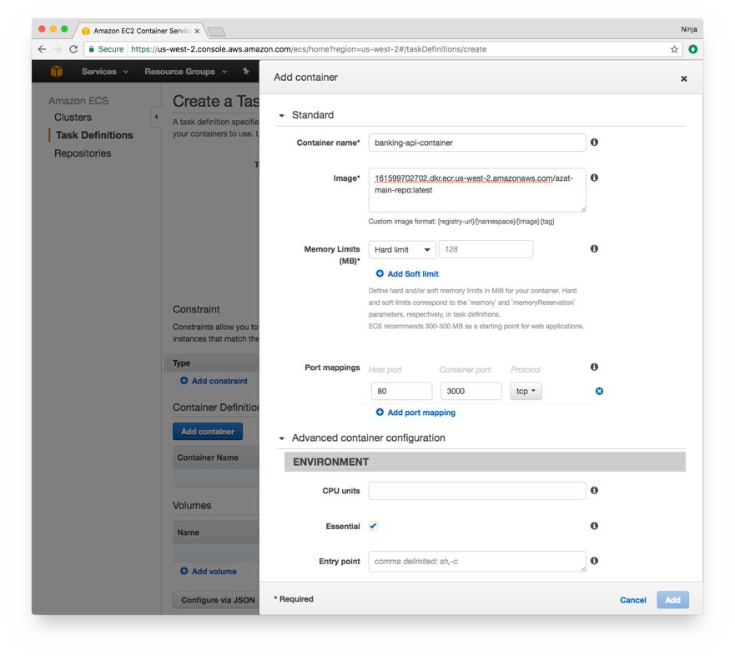
2-aws-containers
Scroll down in the same modal view and add Env Variables:
DB_URI=mongodb://mongod-banking-api-prod-container:27017/db-prod NODE_ENV=production
Add to Links the name of the MongoDB container (not defined yet) to give access to the database container to the app container such as one is the name of the container in the task definition and the other is the host name in the DB_URI:

Slide 15
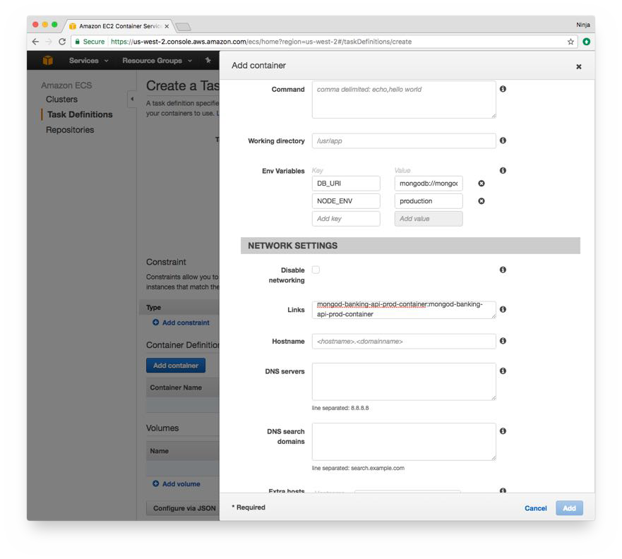
2-aws-containers
mongod-banking-api-prod-container:mongod-banking-api-prod-container
See the screengrab below:

Slide 16
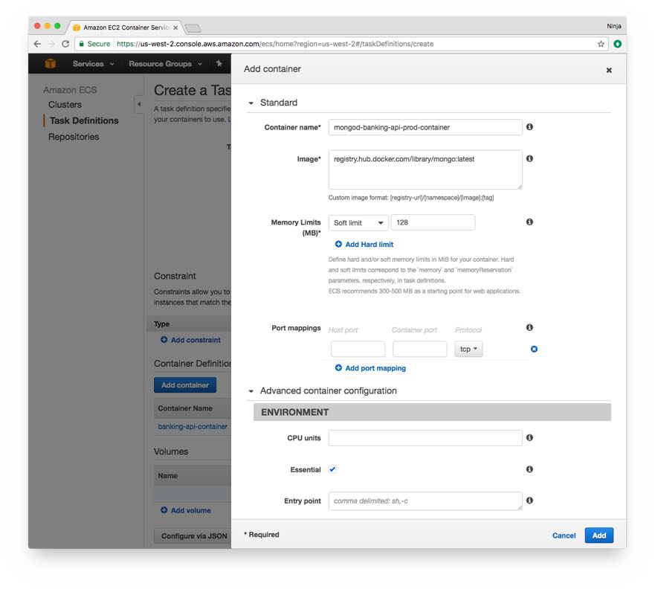
Second container—Database
2-aws-containers
Analogous to the previous container, define name and URL with these values:
Name: mongod-banking-api-prod-container
Image URL: registry.hub.docker.com/library/mongo:latest

Slide 17
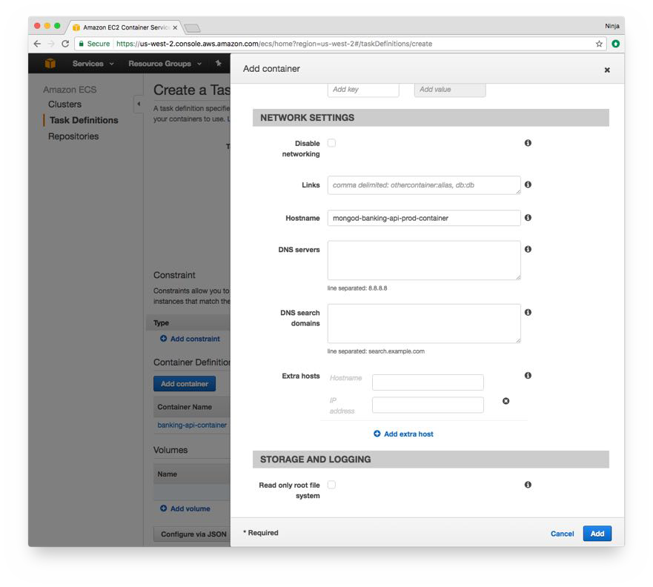
2-aws-containers
Scroll down to the hostname in Network settings and enter Hostname as mongod-banking-api- prod-container as shown below:
After you added two container to the task, create the task and you’ll see a screen similar to the one shown below:

Slide 18
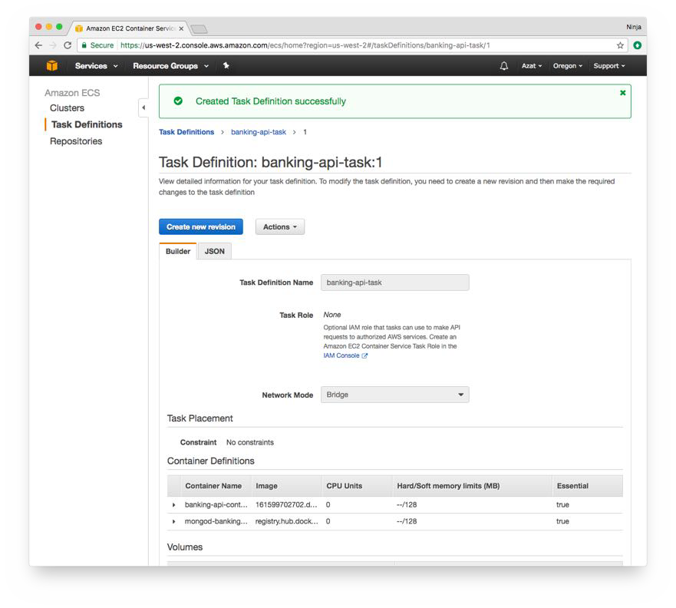
2-aws-containers
Alternatively, you could specify volumes for database or/and the app at the stage of the task creation.

Slide 19
3. Create Cluster
2-aws-containers
Cluster is the place where AWS runs containers. They use configurations similar to EC2 instances. Define the following:
Cluster name: banking-api-cluster
EC2 instance type: m4.large (for more info on EC2 type, see AWS Intro course on Node University)
Number of instances: 1 EBS storage: 22
Key pair: None VPC: New
20 of 28

Slide 20
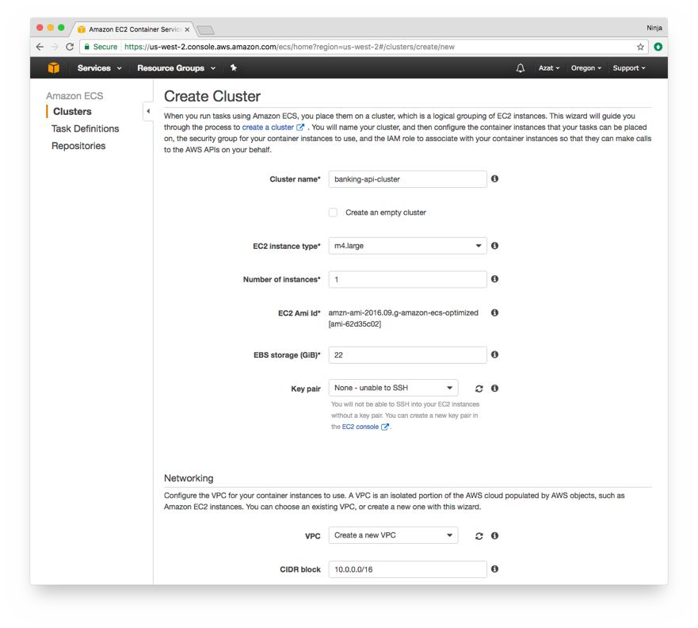
2-aws-containers
Launch the cluster. It might take a few minutes.

Slide 21
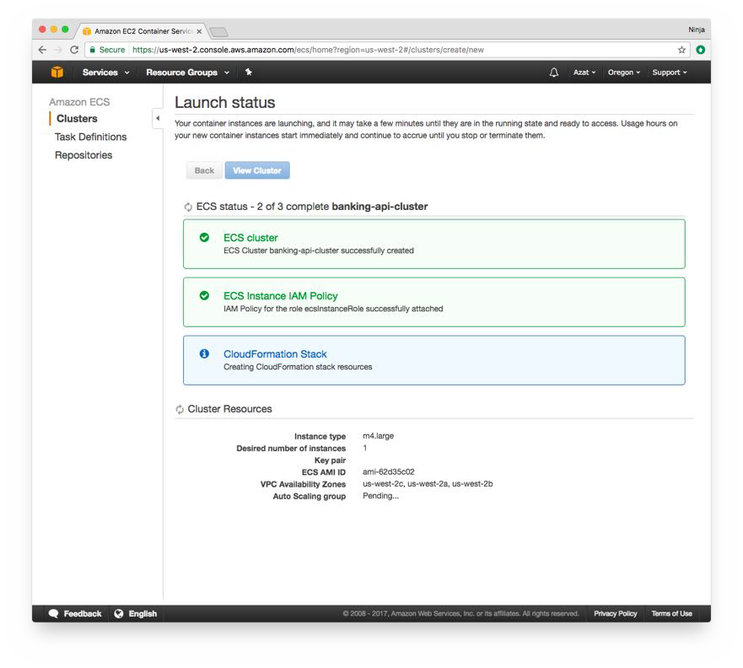
2-aws-containers
You’ll see the progress:

Slide 22
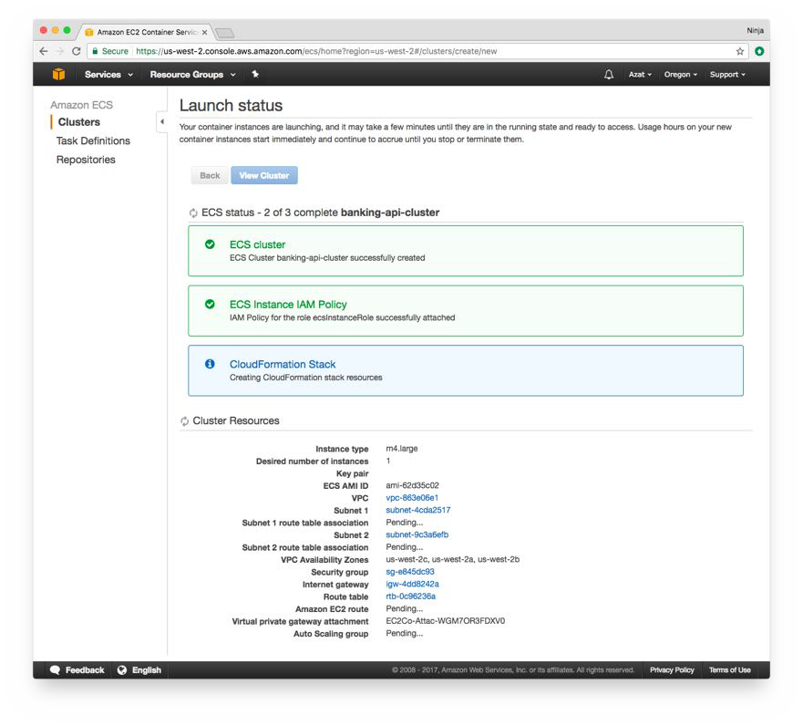
2-aws-containers
ECS creates a lot of EC2 resources for you such as Internet Gateway, VPC, security group, Auto Scaling group, etc. which is great because you don’t have to create them manually.

Slide 23
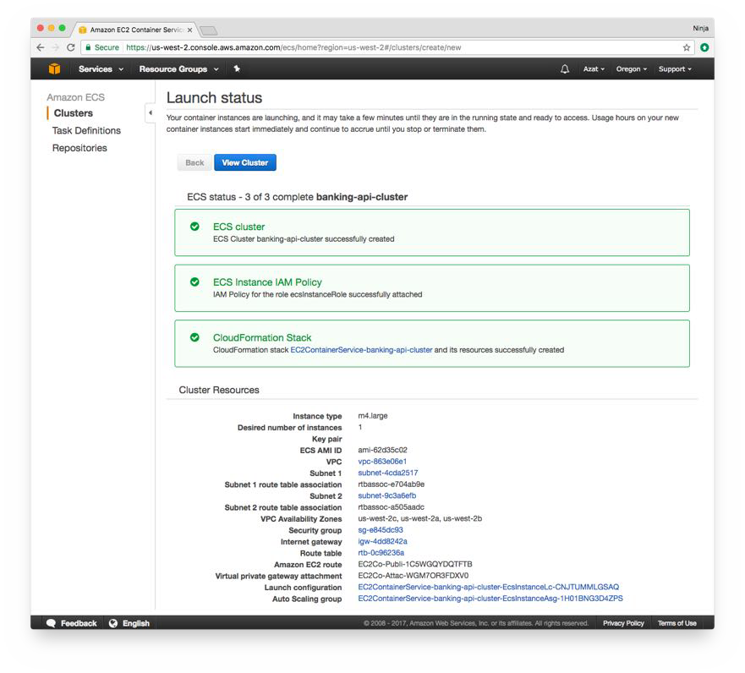
2-aws-containers

Slide 24
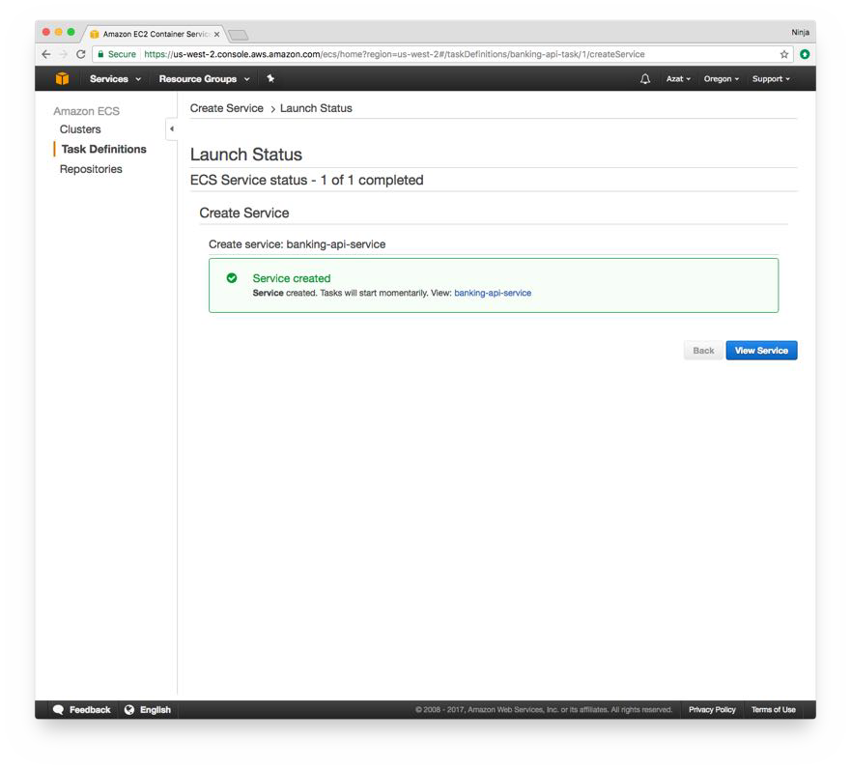
4. Create Service and Verify
2-aws-containers
The last step is to create a service which will take the task and the cluster and make the containers in the task run in the specified cluster. It’s oversimplified explanation because service will do more such as monitor health and restart containers.
Go to Create Services which is under Task Definition -> banking-api-task -> Actions -> Create Service. You will see this:

Slide 25
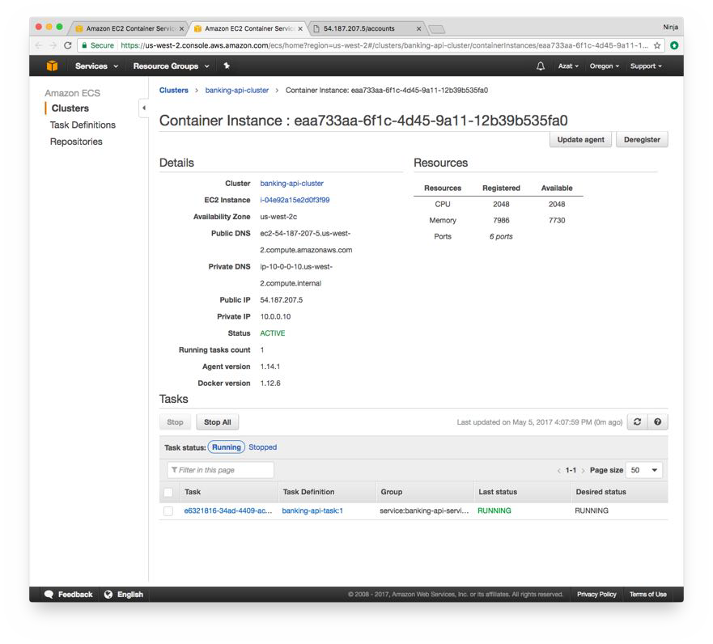
2-aws-containers
Everything is ready
Phew. Everything should be ready by now. To verify, we need to grab a public IP or public DNS. To do so, click Clusters -> banking-api-cluster (cluster name) -> ESC Instances (tab) and Container instance:
Copy public IP or DNS " .
Dynamic Test

Slide 26
2-aws-containers
To test the dynamic content (content generated by the app with the help of a database), open in browser with {PUBLIC_DNS}/accounts. Most likely the response will be [] because the database is empty but that’s a good response. The server is working and can connect to the database from a diﬀerent container.
Static Test
To test the static content such as an image which was downloaded from the Internet by Docker (ADD in Dockerfile) and baked into the image, navigate to http://{PUBLIC_DNS}/node-logo.png to see the images with Docker downloaded via ADD. Using ADD, you can fetch any data such as HTTPS certificates (from a private S3 for example).

Slide 27
Terminate Service and Cluster/Instances
2-aws-containers
Don’t forget to clearn up by terminating your service and instances! You can do it from the web console.

